Slide 1
U.S. fiscal policy and implications for U.S.-China relations
GVC Training Workshop, UIBE, Beijing
August 2018
David Dollar, Senior Fellow
John L. Thornton China Center, Brookings

Slide 2
U.S. tax cuts and implications for U.S.-China
U.S. reduced corporate tax rate to OECD average
Big drop in revenue from corporate/individual cuts
U.S. government debt now on unsustainable path
U.S. interest rates rise, driving up the dollar
Trade imbalance with China likely to widen
China still relatively closed among G20 economies
U.S.-China trade war

Slide 3
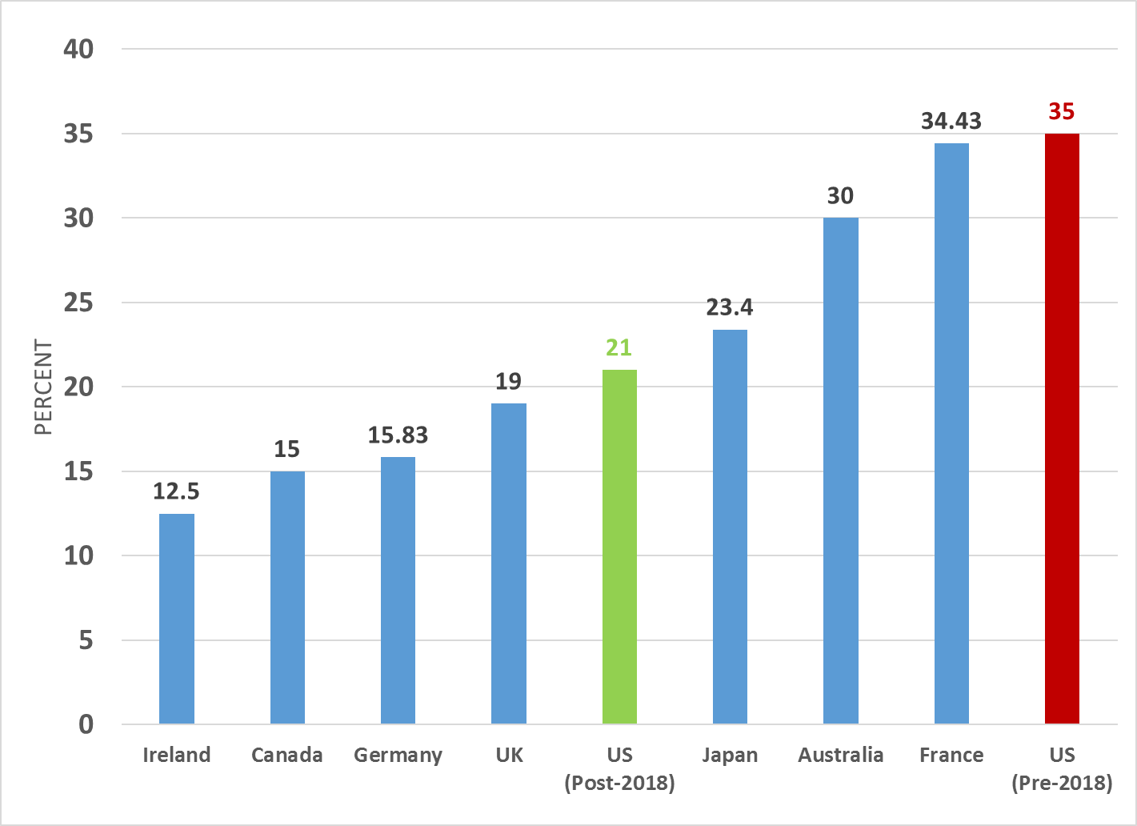
Corporate tax rates for OECD countries
Source: OECD data

Slide 4
U.S. tax cuts and implications for U.S.-China
Cutting corporate rate from 35 to 21% was justified
However, U.S. could have eliminated deductions to make the reform revenue neutral
Instead, corporate plus individual tax cuts reduce revenue by at least $1 trillion over ten years
Despite Trump statements, government expenditure is rising
U.S. debt projected to rise at an unsustainable rate

Slide 5
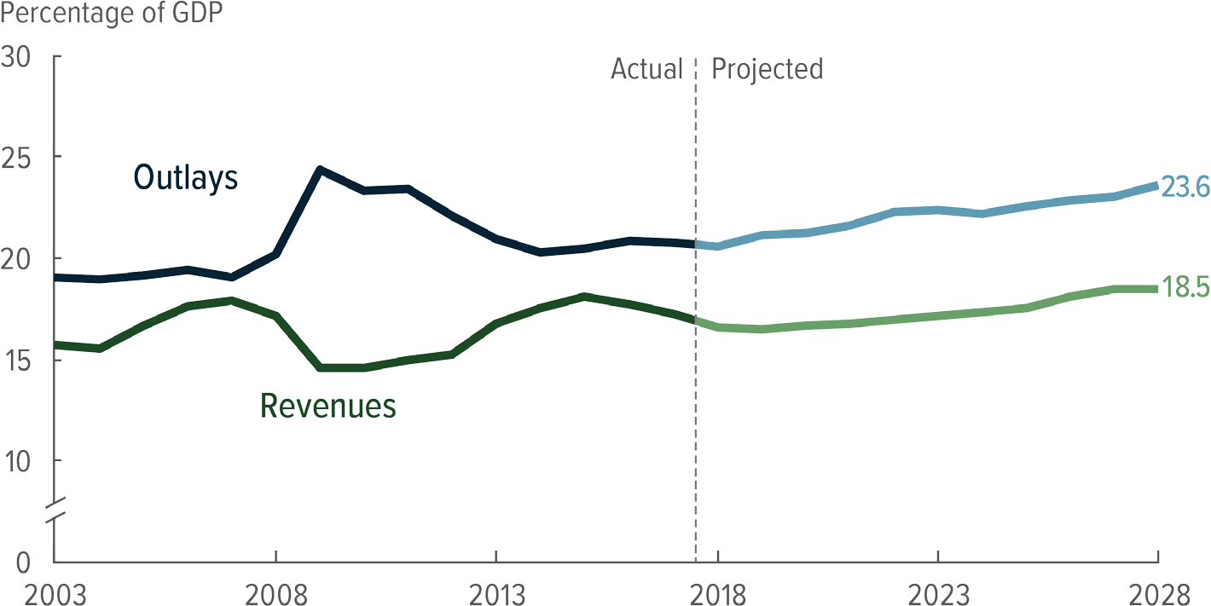
Federal government revenue and outlays

Slide 6
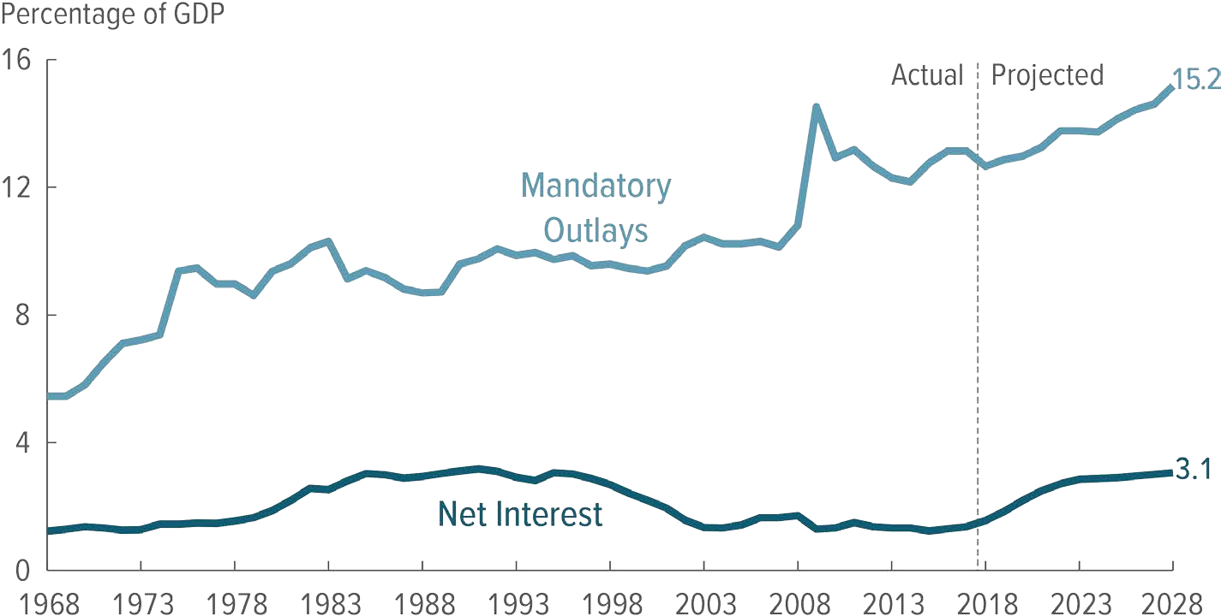
Most expenditure non-discretionary

Slide 7
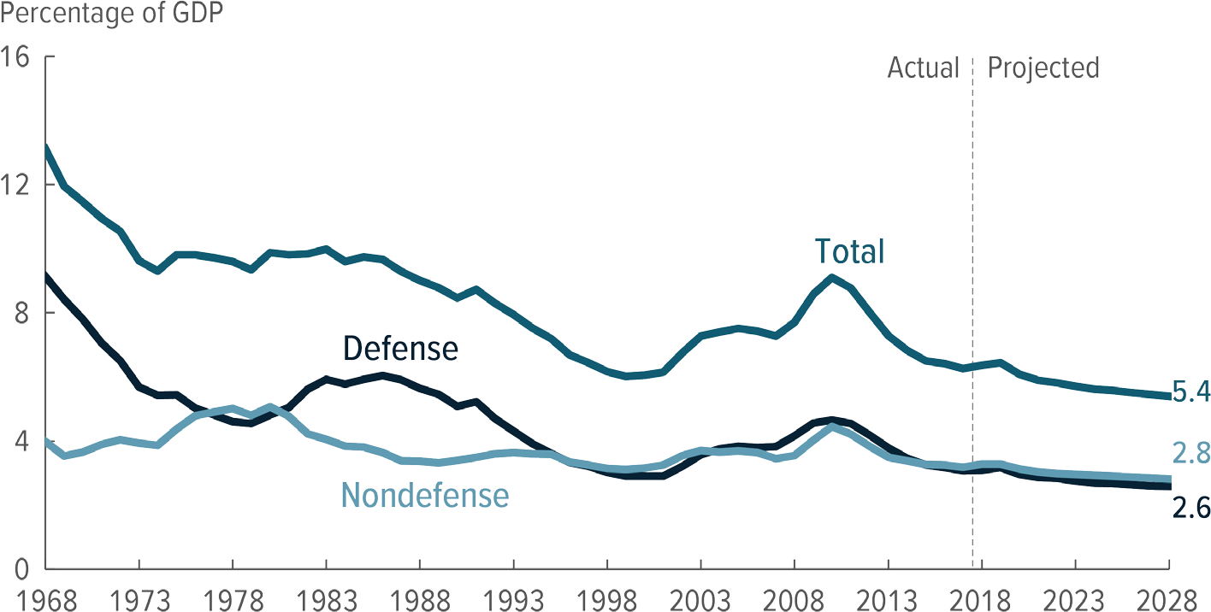
Discretionary spending already low

Slide 8
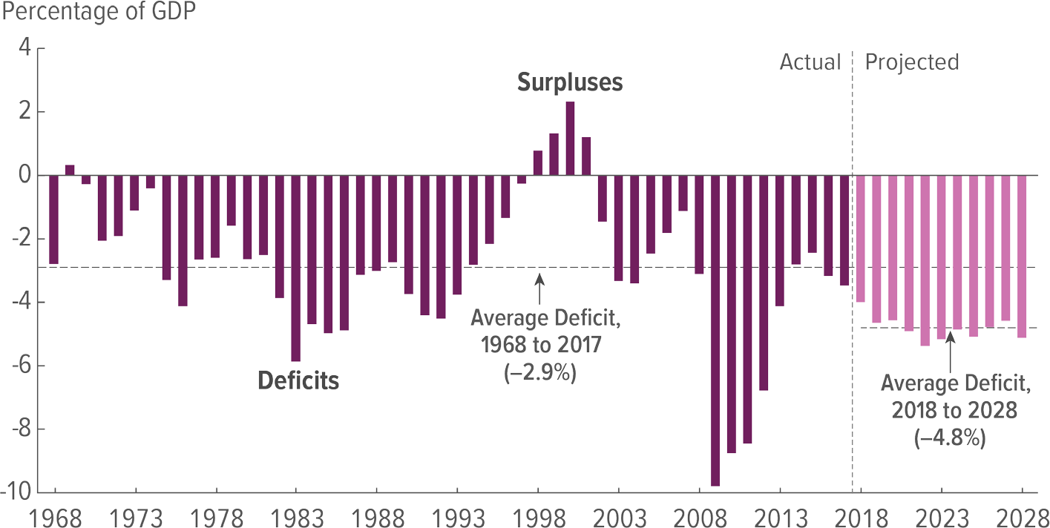
U.S. fiscal deficit rising

Slide 9
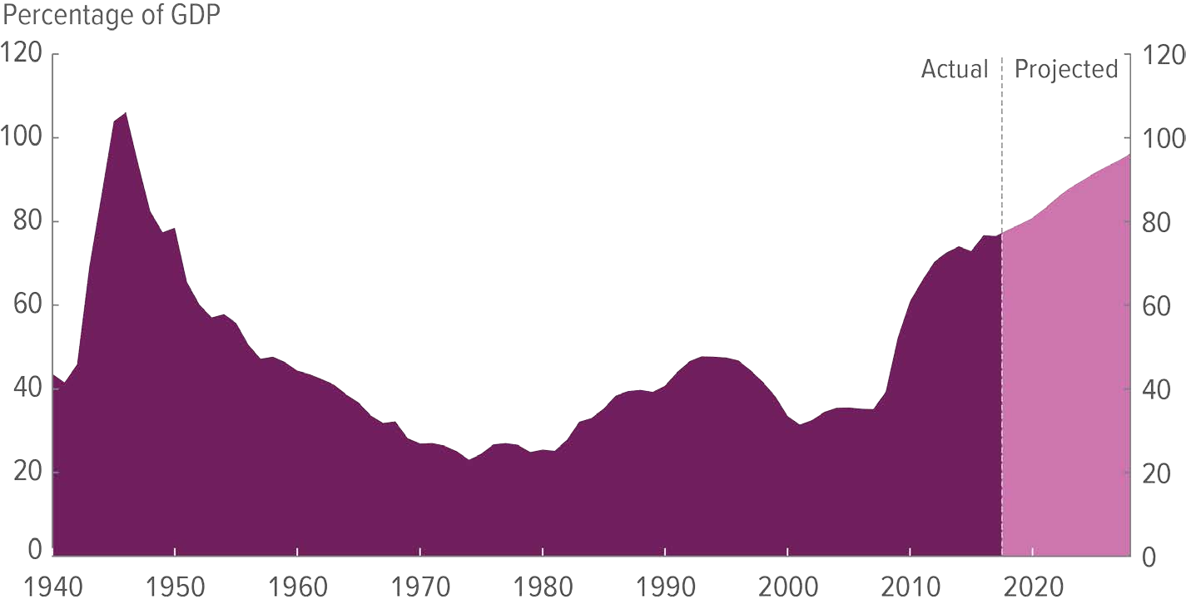
Debt heading to unsustainable levels

Slide 10
U.S. tax cuts and implications for U.S.-China
IMF January 2018 WEO projects additional 0.4 percentage point growth, mostly from investment
U.S. interest rates rise, driving up the dollar
U.S. current account deficit and trade imbalance with China, EU likely to widen

Slide 11
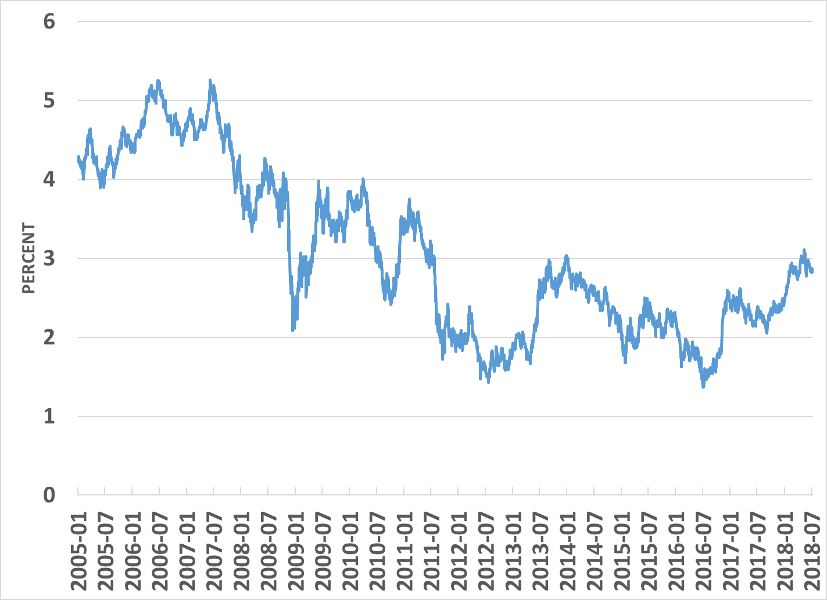
U.S. Ten Year Bond Yield
Source:
St. Louis FED

Slide 12
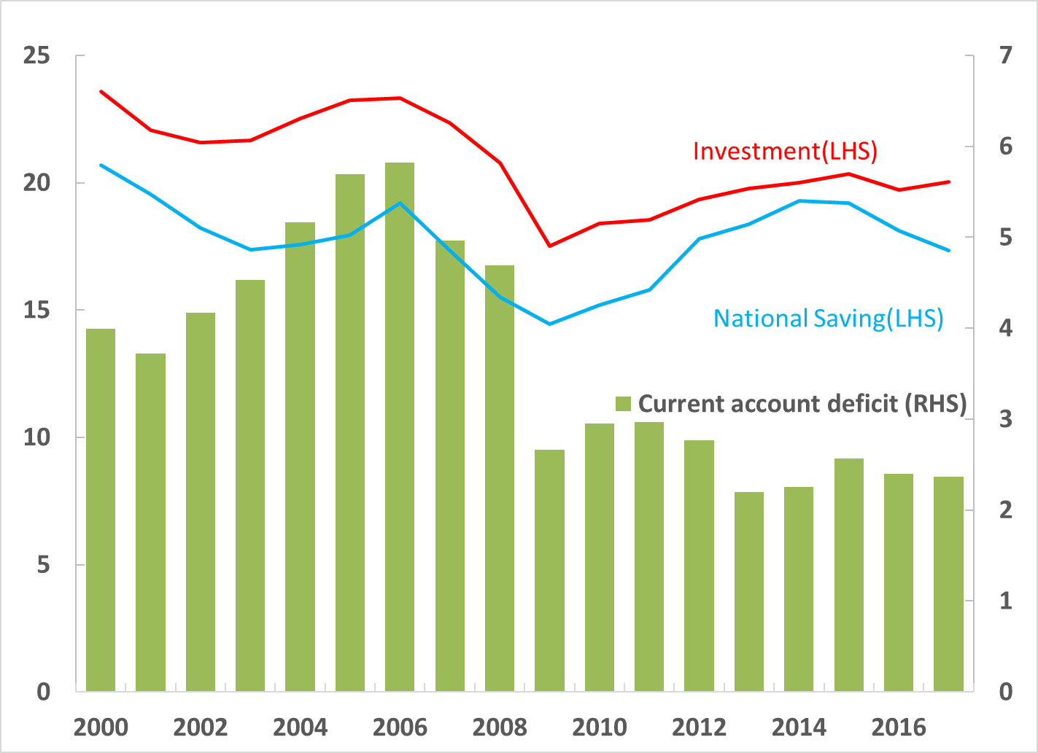
U.S. saving, investment and the current account
Source: WDI

Slide 13
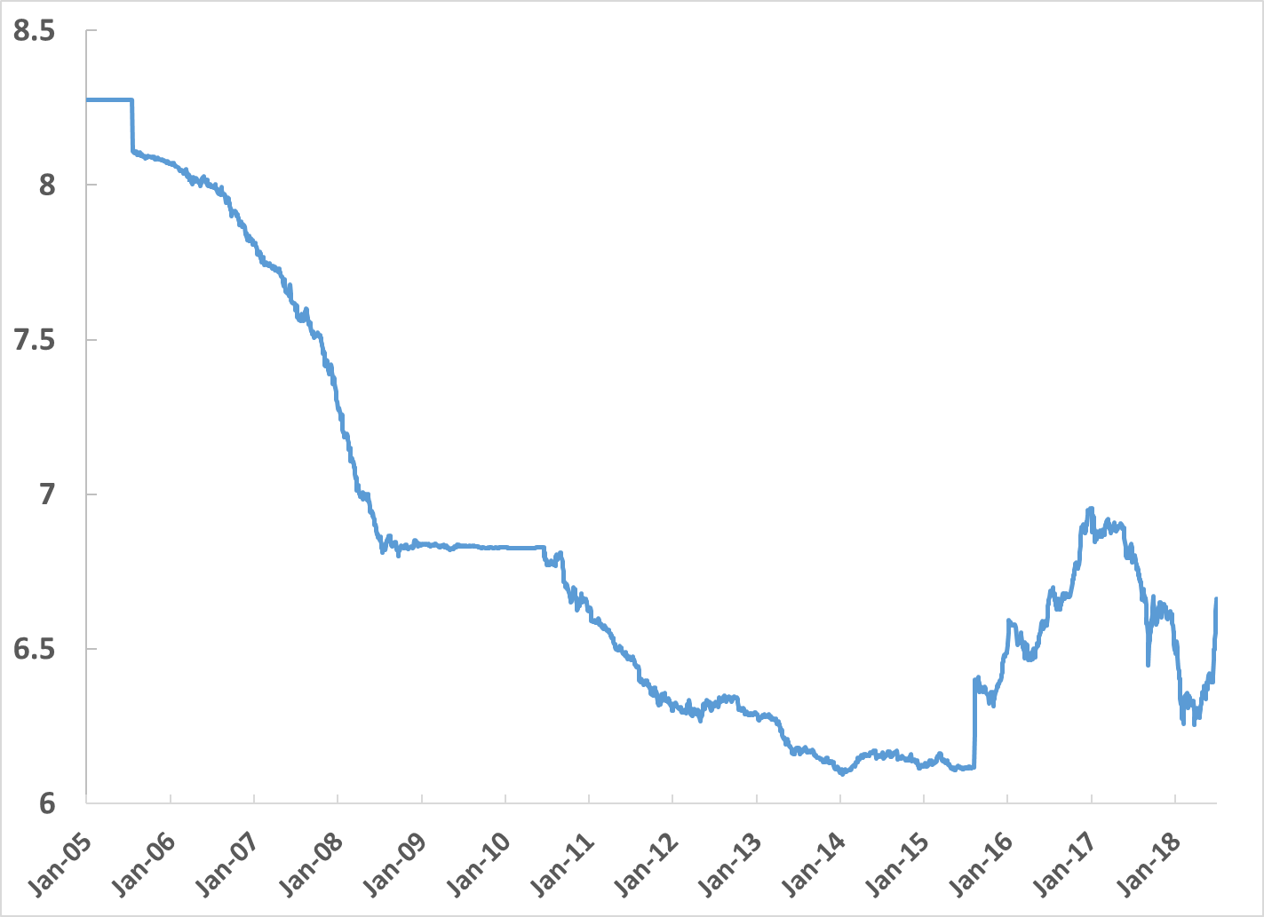
Two-way flexibility in the yuan-dollar rate since 2015

Slide 14
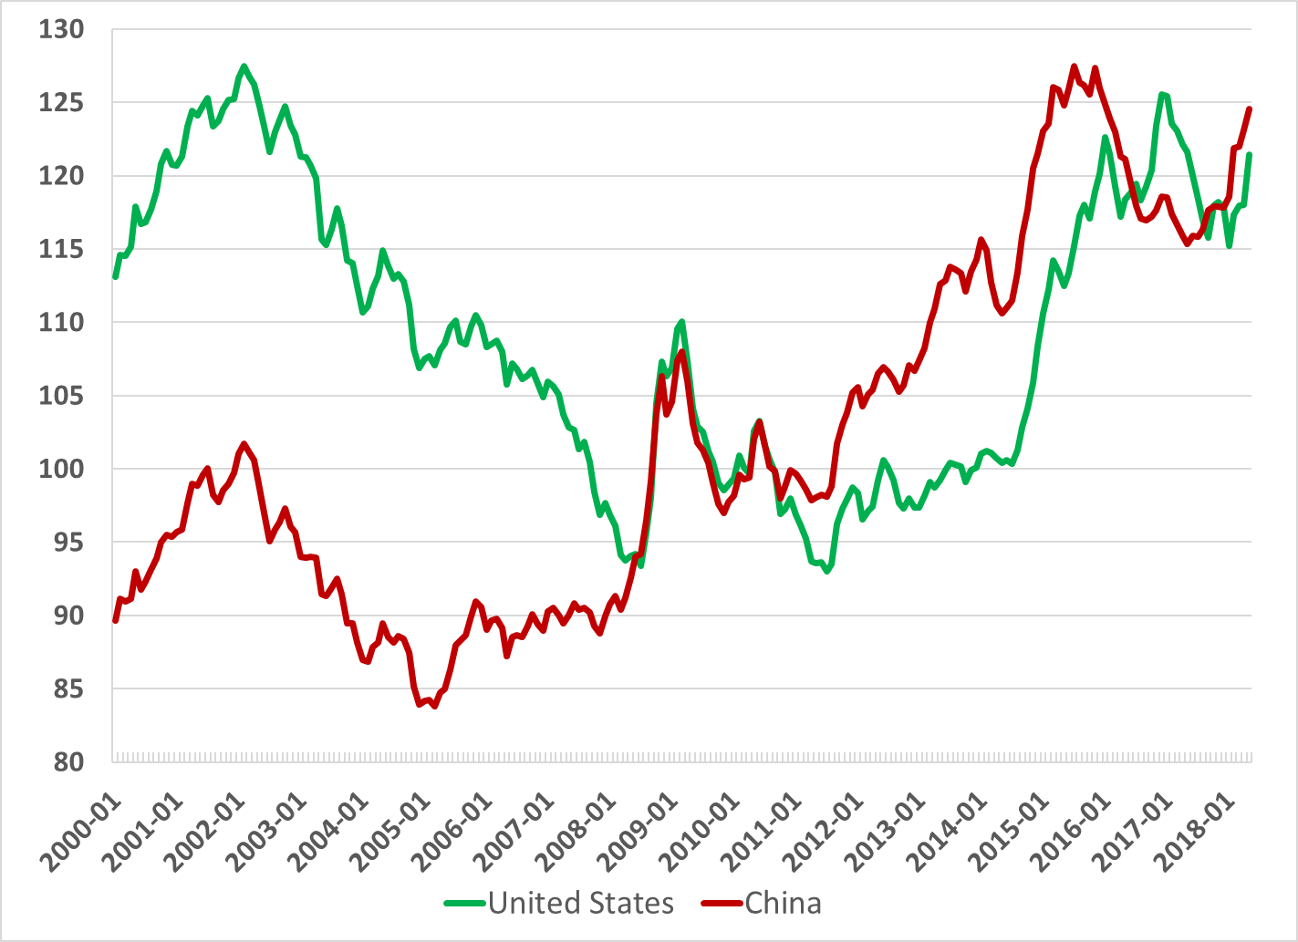
BIS monthly effective ex rate, updated till May 2018

Slide 15
U.S. tax cuts and implications for U.S.-China
Dollar is already high and normally would depreciate from this point, though stimulus may delay that
Long-term trend for the yuan is up about 3 percent per year, owing to productivity growth
Capital outflows could destabilize the yuan

Slide 16
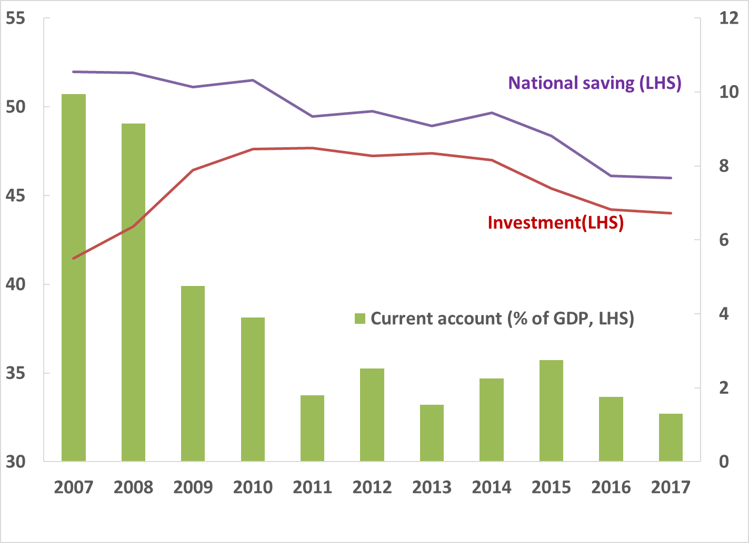
China’s current account surplus has dropped sharply

Slide 17
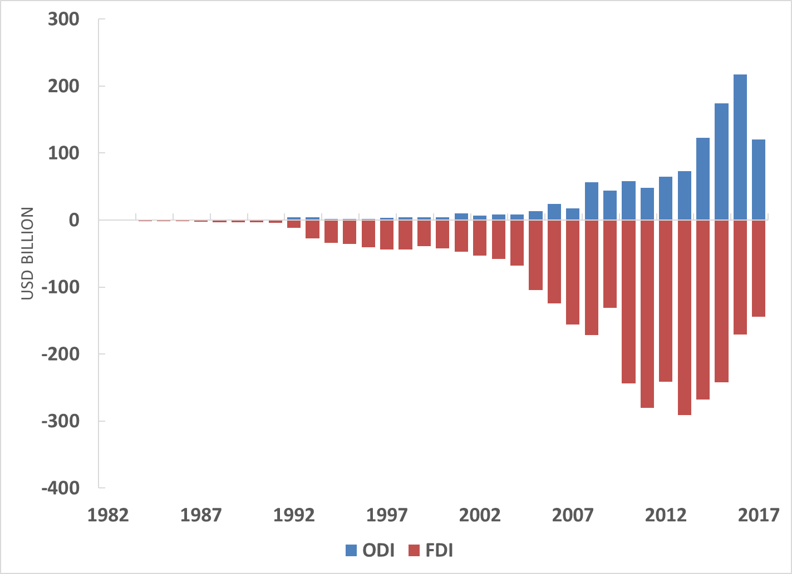
China outward and inward direct investment

Slide 18
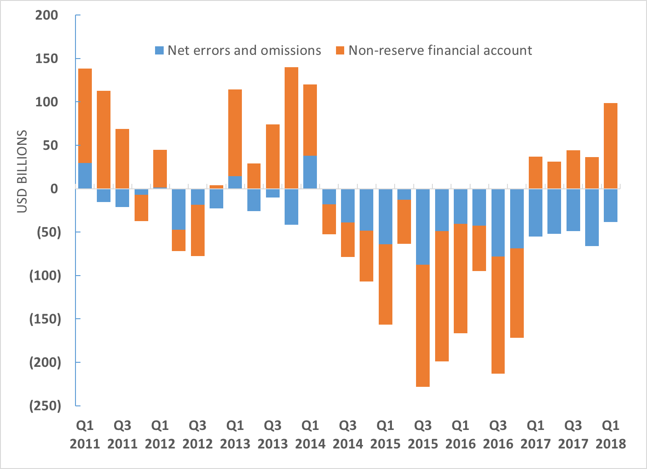
Financial Account and Errors and Omissions
Source: SAFE China

Slide 19
U.S. tax cuts and implications for U.S.-China
U.S. has legitimate market access issues with China
China most closed to FDI among G20 countries
Bilateral trade balance is not a good metric of the economic relationship
Trump administration has launched a trade war with China

Slide 20
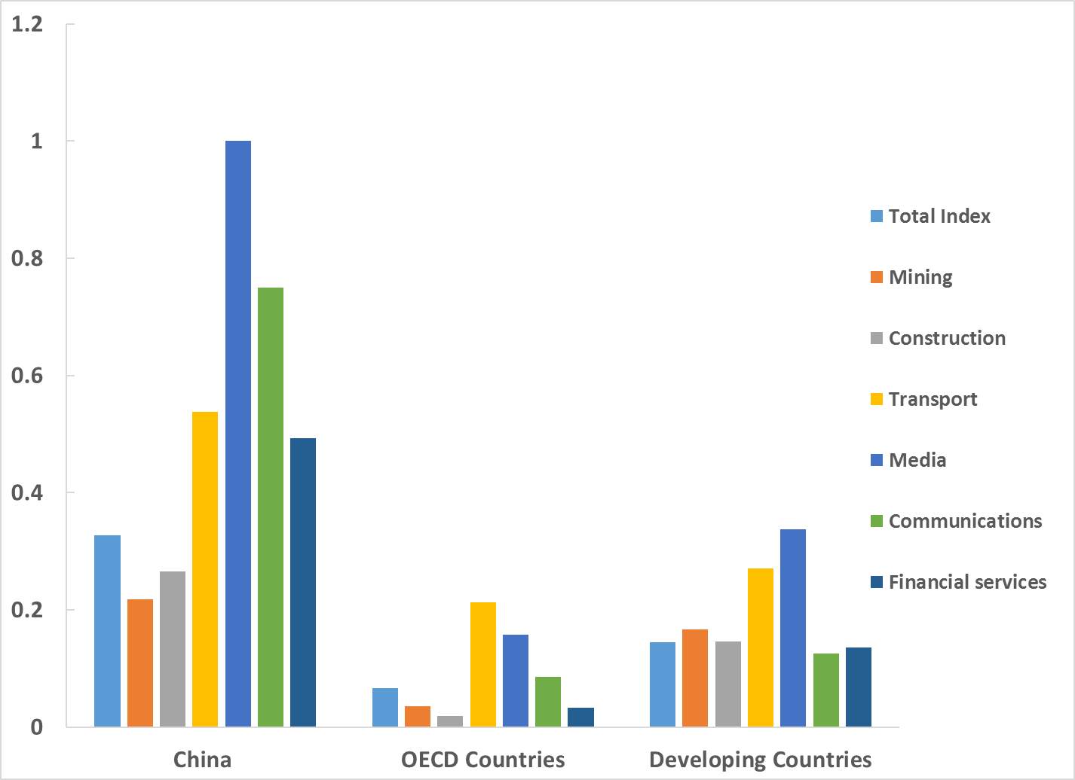
China is most closed among the G20
(FDI restrictiveness index, 2016)

Slide 21
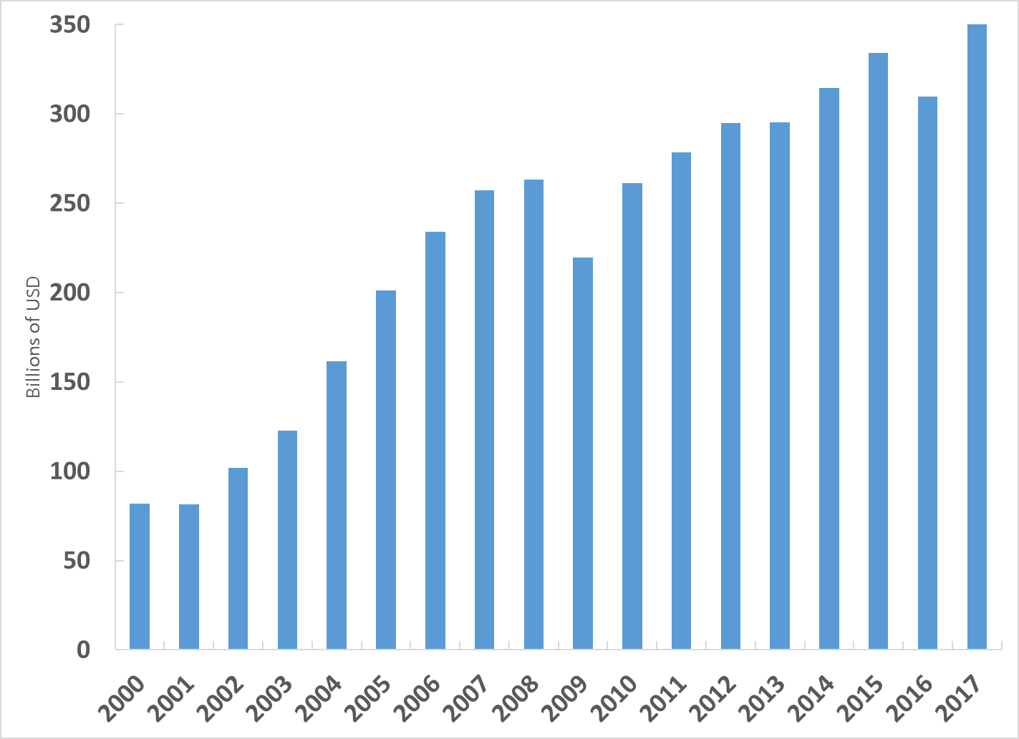
China’s merchandise trade surplus with U.S.

Slide 22
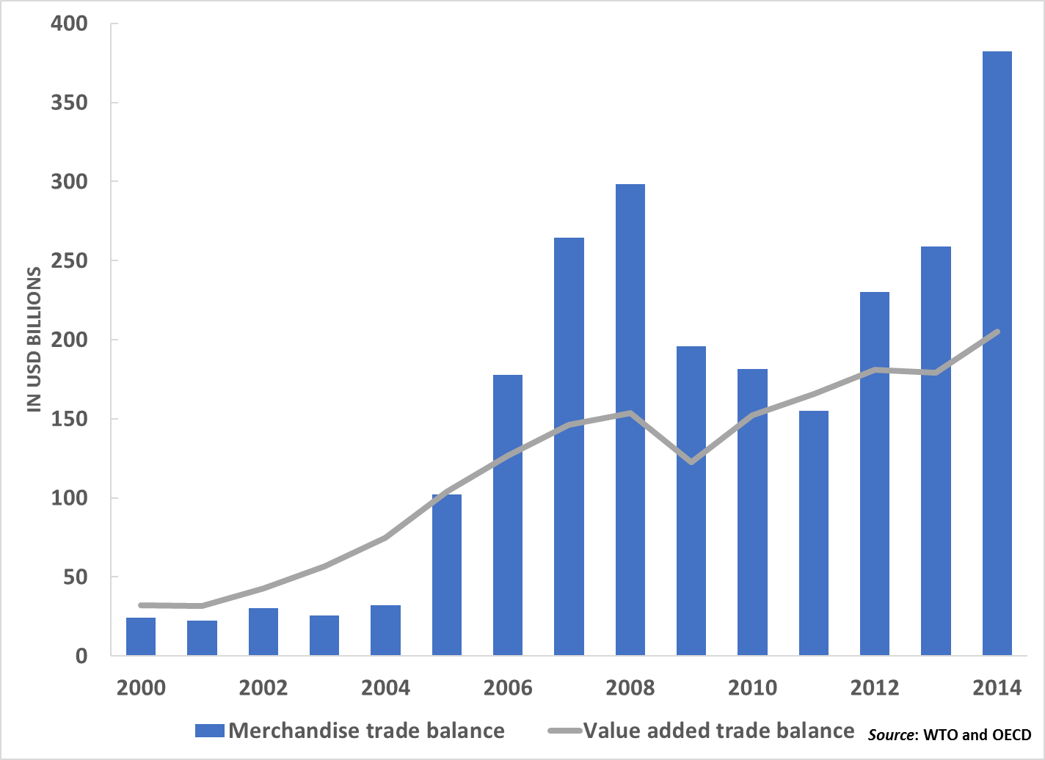
Value added surplus with U.S. is smaller

Slide 23
U.S. trade measures against China
Anti-dumping duties on solar panels and washing machines
Tariffs on steel and aluminum for “national security purposes”
301 investigation of forced technology transfer and IP theft leads to 25% tariff on $50 billion of Chinese exports
China retaliates with 25% on $50 billion of U.S. exports
U.S. identifies $200 billion of Chinese exports for 10% tariff. Chinese retaliation?

Slide 24
U.S. tax cuts and implications for U.S.-China
U.S. reduced corporate tax rate to OECD average
Big drop in revenue from corporate/individual cuts
U.S. government debt now on unsustainable path
U.S. interest rates rise, driving up the dollar
Trade imbalance with China likely to widen
China still relatively closed among G20 economies
U.S.-China trade war

