Slide 1
On the Divergence between CPI and PPI: The Role of Global Value Chains
Shang-Jin Wei and Yinxi Xie
Columbia University
July 25, 2017

Slide 2
Motivation
Monetary policies typically target a single inflation measure – CPI
In theory: the optimal monetary policy may need to take into account both PPI and CPI. (Huang and Liu, JME 2005; Strum, JMCB 2009).
It would not matter much if the two co-move strongly.
CPI and PPI have become more divergent since 2001
Lower correlation between CPI and PPI over time.
Implications:
Given the divergence of the two, monetary policies that pay attention only to CPI inflation are likely to be sub-optimal.

Slide 3
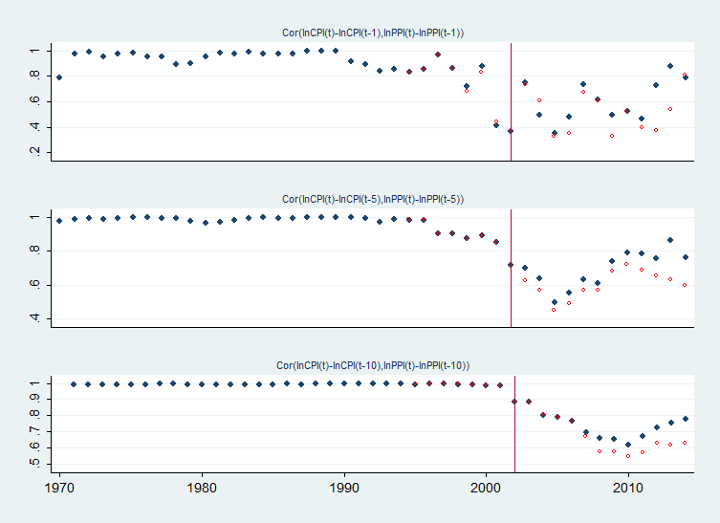
Correlations between changes in CPI and PPI, 1970-2015
Notes:
The correlation is defined as cross-sectional correlations.
Blue points: all sample with CPI and PPI data available
Red points: constant sample with CPI and PPI data available since 1995

Slide 4
Cross-sectional details about changes in CPI and PPI
Notes:
Constant sample since 1995. 1\ Even though the scale of inflation do decrease after 2000, the cross-sectional CPI and PPI inflation are more dispersed since 2001 as illustrated in the graph of 2004. The data near the year of 2004 shows very similar pattern.
2\ We don’t need to specifically emphasize the year 2001.

Slide 5
Time-series correlations between changes in CPI and PPI

Slide 6
Pre-2001 time-series correlations stochastically dominate post-2001
2002-2007
1996-2001
By Kolmogorov-Smirnov test for stochastic dominance, the pre-2001 period stochastically dominates post-2001 period at 5% significance level.
Notes:
The p-value in KS test is 4.2%. For small sample (<50), it is quite conservative. In fact, it could be much more smaller, which means more significant.
The results are robust in terms of 5 year, 6 year, and 7 year, but not 10 year. One reason could that 10 year case includes the crisis period, i.e., the period since 2008.

Slide 7
Monetary policy
Huang and Liu (JME 2005)
New Keynesian framework, and closed economy.
2 stage production function; constant returns to scale at each stage.
Result: Both CPI and PPI appear in the welfare loss function.
Wei and Xie (2017b, still incomplete): Extending Huang and Liu (2005)
G stages of production ; Vertical input-output structure.
Results:
Both CPI and a version of PPI in an optimal Taylor rule;
The weights on PPI and CPI depend on the number of production stages.
Notes:
In Huang and Liu (2005) implies that, as the intermediate goods become more important relative to labor input in processing final goods, the weights on PPI relative to the weights on CPI should be larger.

Slide 8
Monetary policy – welfare loss function
To be short, the welfare loss function can be written as
$$L_{t}=σ{\tilde{c}}_{t}^{2}+θ_{G}κ_{G}^{−1}{\tilde{π}}_{CPI,t}^{2}+\sum_{g=G−1}^{1}{θ_{g}k_{g}^{−1}{\tilde{π}}_{g,t}^{2}φ^{G−g}}+f\left({\tilde{c}}_{t}, {\tilde{q}}_{G,t},⋯,{\tilde{q}}_{2,t}\right)$$
where
${\tilde{c}}_{t}$: consumption gap.
${\tilde{q}}_{g,t}$: relative price gap between stage $g$ and stage $g−1$, $g=2,…,G$.
${\tilde{π}}_{CPI,t}$: consumer price inflation (final stage price inflation).
${\tilde{π}}_{g,t}$: inflation in stage $g$, $g=1,…,G−1$.
$σ$: the relative risk aversion of representative household with respect to consumption.
$k_{g}$ : $(1−βα_{g})(1−α_{g})/α_{g}$, $g=1,…,G$.
$α_{g}$: the probabilities that firms in the stage $g$ can adjust prices are $1−α_{g}$.
$β$: subject discount factor.
$1−φ$: labor share in the production function of each stage .
$θ$: the elasticity of substitution between differentiated goods.
$G$: total number of production stages.
Notes:
1\ f(.) is a messy function, and thus not showed here.
2\ CPI can be viewed as the inflation in the final stage, while PPI (weighted average of all stage prices) reflects more early stage inflation.
3\ As the stage G increases, there are more terms of early stage inflation included in the welfare loss function. In other words, the weights of final stage inflation in welfare loss function becomes smaller, and early stage inflation becomes more important. By intuition, as the stage G increases, PPI should be put higher weights in the rule of optimal monetary policy.

Slide 9
Back to the task of explaining the divergence between PPI and CPI.
Our hypothesis: the lengthening of the production chain plays a key role.

Slide 10
Definition: CPI vs. PPI
CPI
PPI
Services and
Imported final goods that are not in PPI
Domestically produced final goods
Domestically produced intermediate goods
Notes:
CPI vs. PPI
The main difference lies in the coverage of goods and services included in the calculation of the index. First, the CPI covers the set of goods and services purchased for consumption purposes of an average individual or household. Since imports are also purchased by consumers, imports are included in its basket of goods and services. On the other hand, the PPI includes all marketable outputs sold by domestic producers. As such, imports are not included in the calculation of the PPI. Second, while both includes personal consumption in their basket of goods and services, CPI only includes those that are directly paid by consumers and PPI also includes those that are not paid by the consumer (such as third parties and government) (US BLS, 2014).
In some countries, the coverage of services of the CPI is much more extensive than that of the PPI, which creates a large divergence between the two indices (Moreno, 2010).
The purpose of the construction of the indices also differ. The CPI attempts to measure changes in the cost of living, while the PPI is used to deflate revenue to measure real growth in output. (US BLS, 2014).
PPI vs WPI
The PPI is closely related to the WPI and is used as a successor to the WPI in some countries (for eg., US). However, the PPI covers more goods and services and conforms more closely to the System of National Accounts. Moreover, the WPI does not cover retail products (Moreno, 2010).

Slide 11
Production process has experienced a noticeable lengthening since 2001
The Upward Trend of Production Length, World Average
The Production Length of Domestic and International Portion of GVCs, World Average, 1995 to 2011
Source: Wang, Wei, Yu and Zhu (NBER 2017).
Source: Wang, Wei, Yu and Zhu (NBER 2017).

Slide 12
Measurement of the production length (WWYZ, 2017)
Wang, Wei, Yu and Zhu (2017)
Definition: the average number of production stages between the primary inputs in a country-sector to final products in another country/sector.
Construction: the average number of times that value-added created by the prime factors in a country-sector pair has been counted as gross output in the production process until its embodiment in a final product.

Slide 13
Measurement of the production length (WWYZ, 2017)
Idea: average number of country-sectors from the primary factors to the final consumption
$$PL_GVC=PLd_GVC+PLi_GVC=\frac{Xd_GVC}{VY_GVC}+\frac{Xi_GVC}{VY_GVC}$$
$PL_GVC$ : the total average production length of domestic value-added of source country embodied in its bilateral intermediate exports.
$PLd_GVC$ : the average domestic length of GVC production.
$PLi_GVC$ : the average international length of source country’s GVC production.
$VY_GVC$ : the amount of domestic value added generated from the production of gross intermediate exports.
$Xd_GVC$ : the domestic gross output generated by GVC production activities.
$Xi_GVC$ : the total international (foreign) gross outputs induced by domestic value-added of source country embodied in its GVC related intermediate exports.
Actual application: using an WIOD inter-country input-output table with G countries and N sectors. G=40, N=35.

Slide 14
Production process has experienced a noticeable lengthening since 2001
The Upward Trend of Production Length, World Average
The Production Length of Domestic and International Portion of GVCs, World Average, 1995 to 2011
Source: Wang, Wei, Yu and Zhu (NBER 2017).
Source: Wang, Wei, Yu and Zhu (NBER 2017).

Slide 15
Why has the production process become longer?
China’s accession to the World Trade Organization in December 2001
Integration took place in phases over the next five years
US trade liberalization: Permanent Normal Trading Relations to China in 2000, equivalent a reduction of tariff by 13 pct (Handley and Limao, NBER 2013).
Greater European Integration
Rise of central and eastern Europe as part of the global value chains.
Greater modularization/digitalization makes it easier to “slice up” the production process.
With an improvement in digitalization, or codifiability, firms are associated with larger probability of fragmentation during production process due to lower coordination costs (Fort, Restud 2017).
Notes:
Prof Wei mentioned about adding US PNTR.

Slide 16
As these developments take place, even when one holds the composition of the CPI basket constant, the PPI basket would have progressively more intermediate goods that do not directly belong to the CPI.
Shocks now more likely generate divergent movements in the two indices.
Notes:
Yinxi: I added “directly” here.

Slide 18
Rising of PRC in Exports….

Slide 19
Notes:
It’s right that the units on the right axis is 100 billions.

Slide 20
More visible rise in Gross Output/GDP in some countries
China
Korea
Taiwan
Poland
Germany
Brazil
Notes:
The data comes from WIOD database starting from 1995.

Slide 21
Help: looking for a graph that visualizes increasing modularization of production
+ references

Slide 22
Future policy experiment: Trump may undo-GVC
Financial Times, Jan 31, 2017
“Peter Navarro, the head of a new White House National Trade Council, says one of the Trump administration’s trade priorities is unwinding and repatriating the international supply chains on which many US multinational companies rely.
Mr Trump’s spokesman suggested that the proposal was one way to finance a wall on the Mexican border.”

Slide 23
Roadmap of this research
Objective: How does the lengthening of the production process affect the correlation between CPI and PPI?
Clarification
GVC lengthening could happen due to technology reasons, trade costs, or both. We will focus on an exogenous technological change.
Do not ask what causes the lengthening of the production process; only study its consequences.

Slide 24
Key idea
As the production process becomes more fragmented, while the CPI basket does not change, the PPI basket will have more intermediate goods.
the composition of CPI and PPI become more different.

Slide 25
Roadmap
I. Theory
G stages of production for tradable manufacturing goods
Eaton-Kortum in each stage
Study how corr (ΔPPI, ΔCPI) changes with G in response to shocks
II. Empirics
(a) Responses of CPI and PPI to industrial input price shocks (a proxy for a productivity shock to Stage-1 production);
(b) Calibrate the theoretical responses of CPI and PPI to productivity shock using the World Input-Output Database;
(c) Compare (a) and (b).

Slide 26
Literature
Macroeconomics about CPI and PPI as inflation gauges
Huang and Liu (JME 2005), Edwards (NBER 2006), De Paoli (JIE 2009), Strum (JMCB 2009), etc.
Global value chains, or vertical fragmentation
Hummels, Ishii and Yi (JIE 2001), Yi (JPE 2003), Johnson and Noguera (JIE 2009), Yi (AER 2010), Costinot, Vogel and Wang (RES 2013), Ramondo and Rodriguez-Clare (JPE 2013), Koopman, Wang and Wei (AER 2014), Antras and Gortari (2017), etc.
International transmissions of the business cycles
Ambler, Cardia and Zimmermann (EER 2002), Kose, Prasad and Terrones (AER 2003), Boivin and Giannoni (NBER 2008), Monacelli and Sala (JMCB 2009), Mumtaz and Surico (JEEA 2012), Jin and Li (Mimeo 2012), Acemoglu et al (NBER 2015), Auer et al (Mimeo 2016), etc.
Notes:
It should be De Paoli (JIE 2009) instead of Paoli (JIE 2008).

Slide 27
Model settings – production
N countries, $n=1,2,…,N$.
Two sectors, i.e., tradable manufacturing sector, “m”, and non-tradable service sector, “s”.
$G$ = # production stages in manufacturing sector; single stage in service sector.
Unit continuum of goods $u∈[0,1]$ within each sector and each stage.
Production structure – to be explained later
Market structure
Service output domestically consumed.
The final-stage manufacturing goods are either consumed at home or exported.
Households purchase differentiated final manufactured goods from all countries and aggregate them to a composite.

Slide 28
Model settings – households and trade
Households
Fixed labor supply in each country, i.e., $L^{n}$.
Cobb-Douglas utility function over the manufacturing composite and service composite, i.e.,
$$U^{n}={Q^{n}}^{α}{S^{n}}^{1−α}$$
Trade assumptions
Iceberg costs, i.e., $τ^{in}$, when shipping from country $i$ to $n$.
The markets are perfectly competitive.
Good-specific productivity
Independently drawn across countries, sectors, stages and goods.
The productivity $Z$ is drawn from a Frechet distribution, i.e.,
$\operatorname{Pr}\left(Z<z\right)=F\left(z\right)=exp⁡(−T⋅z^{−κ})$

Slide 29
Production in the (tradable) manufacturing sector
For country $n$, in stage one, labor is the only input, and the production function in manufacturing sector is given by
$$q_{1}^{n}\left(u\right)=Z_{1}^{n}\left(u\right)l_{1}^{n}(u)$$
In each subsequent stage, $g=2,⋯,G$, there are two sub-steps:
Purchasing outputs in the previous stage from all the countries to form a composite intermediate good, i.e.,
$${\overline{q}}_{g}^{n}=exp⁡(\int_{0}^{1}{\log\left({\tilde{q}}_{g−1}^{n} \left(u\right)\right)du)}$$
Using the composite intermediate good together with labor to produce outputs of current stage, i.e.,
$$q_{g}^{n}\left(u\right)=Θ⋅Z_{g}^{n}\left(u\right){\overline{q}}_{g}^{n}{\left(u\right)}^{θ}l_{g}^{n}{\left(u\right)}^{1−θ}$$
$Θ={\left[{\left(1−θ\right)}^{1−θ}θ^{θ}\right]}^{−1}$ is a constant for normalization.

Slide 30
Service Sector
For country $n$, the service sector production is given by
$$s_{}^{n}\left(u\right)=Z_{s}^{n}\left(u\right)l_{s}^{n}(u)$$
Households purchase the manufacturing and service outputs and form two composites, i.e.,
Manufacturing composite:
$$Q^{n}=exp⁡(\int_{0}^{1}{\log\left({\tilde{q}}_{G}^{n} \left(u\right)\right)du)}$$
Service composite:
$$S^{n}=exp⁡(\int_{0}^{1}{\log\left(s_{}^{n} \left(u\right)\right)du)}$$

Slide 31
Production structure
Manufacturing sector
labor
Outputs from abroad
Stage 1
Production
Aggregation
labor
Stage 2
Outputs from abroad
Production
Outputs from abroad
...
Service sector
Aggregation
labor
Stage G
labor
Production
Production
Manufacturing outputs from abroad
Households

Slide 32
General equilibrium: price assignment in the manufacturing sector
For stage $g$ in country $n$, the purchasing price of input produced in stage g-1 is ${\tilde{p}}_{g−1}^{n}\left(u\right)=\min_{i}{\{p_{g−1}^{in}\}}$, where $p_{g−1}^{in}={c^{i}τ^{in}}/{Z_{g}^{i}}$ and $c^{i}$ is the unit cost.
By standard EK, we know
$$G_{g−1}^{n}\left(p\right)=\operatorname{Pr}\left({\tilde{p}}_{g−1}^{n}\left(u\right)≤p\right)=1−\exp\left(−Φ_{g−1}^{n}p^{κ}\right)$$
where $Φ_{g−1}^{n}=Σ_{i}T_{g−1}^{i}{\left(c^{i}τ^{in}\right)}^{−κ}$
The composite intermediate good in stage $g$ of country $n$ is given by
$${\overline{p}}_{g}^{n}=exp⁡(\int_{0}^{1}{\log\left({\tilde{p}}_{g−1}^{n} \left(u\right)\right)du)}={\left(Φ_{g−1}^{n}\right)}^{−1/κ}$$
The price of final manufacturing composite good:
$$P^{n}(m)=exp⁡(\int_{0}^{1}{\log\left({\tilde{p}}_{G}^{n} \left(u\right)\right)du)}={\left(Φ_{G}^{n}\right)}^{−1/κ}$$

Slide 33
General equilibrium: price assignment in the service sector
Since the output is non-tradable, the price of good $u$ is:
$$p_{s}^{n}\left(u\right)=w^{n}/Z_{s}^{n}\left(u\right)$$
By CES aggregation, the price of service composite in country $n$ is
$$P^{n}(s)=exp⁡(\int_{0}^{1}{\log\left(p_{s}^{n} \left(u\right)\right)du)}=\exp{(−\frac{γ}{κ})}{\left(T_{s}^{n}\right)}^{−\frac{1}{κ}}w^{n}$$
where $γ$ is Euler’s constant.

Slide 34
CPI definition
Given wage assignment in all the countries, $\{w^{1},⋯,w^{N}\}$, the CPI in country $n$ is given by
$$CPI^{n}=P^{n}{\left(m\right)}^{α}P^{n}{\left(s\right)}^{1−α}$$
where $P^{n}\left(s\right)=\exp{(−\frac{γ}{κ})}{\left(T_{s}^{n}\right)}^{−1/κ}w^{n}$, $P^{n}\left(m\right)={\left(Φ_{G}^{n}\right)}^{−1/κ}$.
Note that $Φ_{G}^{n}$ is derived by forward induction, i.e.,
$$Φ_{1}^{n}=\sum_{i=1}^{N}{{T_{1}^{i}\left(w_{}^{i}τ^{in}\right)}^{−κ}}$$
$$Φ_{g}^{n}=\sum_{i=1}^{N}{{T_{g}^{i}[τ^{in}{\left(w^{i}\right)}^{1−θ}{\left(Φ_{g−1}^{i}\right)}^{−θ/κ}]}^{−κ}}, g=2,⋯,G$$

Slide 35
General equilibrium: quantity assignment in the manufacturing sector
Let $X_{g}^{n}$ be country $n$’s total expenditure on purchasing output produced in stage $g$, and $X_{g}^{in}$ be the total spending of country $n$ on goods from country $i$
By standard EK, we know
$$\frac{X_{g}^{in}}{X_{g}^{n}}={T_{g}^{i}{\left[τ^{in}{\left(w^{i}\right)}^{1−θ}{\left(Φ_{g−1}^{i} \right)}^{−\frac{θ}{κ}}\right]}^{−κ}}/{Φ_{g}^{n}}, g=2,⋯,G$$
The total earnings of country $i$ at the end of stage $g$ is given by
$$E_{g}^{i}=Σ_{n}X_{g}^{in}$$
By production function, $1−θ$ fraction of the total earnings will be paid to households, and $θ$ to purchase inputs. Thus, for country $n$,
$$X_{g}^{n}=θE_{g}^{n}$$

Slide 36
PPI definition
Given wage assignment, $\{w^{1},⋯,w^{N}\}$, the PPI in country $n$ is:
$$PPI^{n}={\left[\frac{w^{n}}{exp\left(\frac{γ}{κ}\right){\left(T_{1}^{n}\right)}^{\frac{1}{κ}}}\right]}^{ω_{1}^{n}}Π_{g=2}^{G}{\left[\frac{{\left(w^{n}\right)}^{1−θ}{\left(Φ_{g−1}^{n}\right)}^{−θ/κ}}{exp\left(\frac{γ}{κ}\right){\left(T_{g}^{n}\right)}^{\frac{1}{κ}}}\right]}^{ω_{g}^{n}}$$
where $ω_{g}^{n}=\frac{E_{g}^{n}}{\sum_{g=1}^{G}{E_{g}^{n}}}$, $g=1,⋯,G$, & $E_{g}^{n}$ = total earnings of country $n$ in stage $g$.
Note that $E_{g}^{n}$ is given by backward induction, i.e.,
$$X_{G}^{n}=αw^{n}L^{n}$$
$E_{g}^{n}=\sum_{i=1}^{N}{\frac{T_{g}^{n}{\left[τ^{ni}{\left(w^{n}\right)}^{1−θ}{\left(Φ_{g−1}^{n} \right)}^{−\frac{θ}{κ}}\right]}^{−κ}}{Φ_{g}^{i}}}X_{g}^{i}$, $g=2,⋯, G$
$X_{g−1}^{n}=θE_{g}^{n}$, $g=2, ⋯, G$
$$E_{1}^{n}=\sum_{i=1}^{N}{\frac{T_{1}^{n}{\left[τ^{ni}w^{n}\right]}^{−κ}}{Φ_{1}^{i}}}X_{1}^{i}$$

Slide 37
Market clearing conditions
Given wage assignment in all the countries, total labor demand in each country is determined.
Since labor supply is fixed in each country, wages will be adjusted to clear the labor market
A system of N-1 independent equations
the wage assignment $\{w^{1},⋯,w^{N}\}$ up to a numeraire.

Slide 38
CPI and PPI response to productivity shocks and trade cost shocks
Common shock on the first stage of manufacturing sector, common shock on trade costs, and country-specific shock on service sector
$\hat{lnT_{1}^{n}}=ε_{m}, ∀n$, $\hat{lnτ_{}^{in}}=ε_{τ}, ∀i,n$, $\hat{lnT_{s}^{n}}=ε_{s}^{n}, ∀n$
The response of CPI and PPI inflation are given by
$$\hat{lnCPI^{n}}=−\frac{1−α}{κ}ε_{s}^{n}−\frac{α}{κ}θ^{G−1}ε_{m}+α\frac{1−θ^{G}}{1−θ}ε_{τ}$$
$$\hat{lnPPI^{n}}=−\left(\sum_{g=1}^{G}{\frac{ω_{g}^{n}}{κ}θ^{G−1}}\right)ε_{m}+\left[\sum_{g=2}^{G}{ω_{g}^{n}\frac{θ−θ^{g}}{1−θ}}\right]ε_{τ}$$
Note that
$α$: Cobb-Douglas preference on manufacturing goods.
$κ$ : shape parameter measuring the distribution of productivity.
$1−θ$: labor share in production function.
$G$: total number of production stages.

Slide 39
Additional analytical results under more assumptions
Assumptions
Unit continuum of countries $n∈[0,1]$.
Symmetric countries, i.e., the same labor supply, the same productivity distribution across countries for each stage.
Identical trade costs, i.e., $τ^{in}=τ$ for $∀i,n$.
Implications
The wages are the same, i.e., $w^{n}=w$ for $∀n$.
Trade takes place (only) because of the random realizations of productivities.
Notes:
Prof Wei’s question for the last bullet point: isn’t this true for the general model?
In the general model, trade takes place not only because of the random realization of productivities, but also depends on trade costs.

Slide 40
PPI and CPI
CPI and PPI are given by
$$lnCPI=−\frac{1−α}{κ}lnT_{s}−\left[\sum_{g=1}^{G}{\frac{α}{κ}θ^{G−g}lnT_{g}}\right]+\frac{α\left(1−θ^{G}\right)}{1−θ}lnτ+lnw$$
$$lnPPI=\frac{γ}{κ}−\left[\sum_{g=1}^{G}{\frac{θ^{G−g}\left(1−θ\right)\left(G−g+1\right)}{κ\left(1−θ^{G}\right)}lnT_{g}}\right]+\frac{θ[1−θ^{G}−Gθ^{G−1}(1−θ)]}{\left(1−θ\right)(1−θ^{G})}lnτ+lnw$$
$T_{s}$: location parameter measuring the geometric mean of productivity in service sector.
$T_{g}$: location parameter measuring the geometric mean of productivity of stage $g$ in manufacturing sector.
$τ$ : trade cost.
$w$: wage for all the countries.
$γ$: a constant.
$κ$ : shape parameter measuring the distribution of productivity.

Slide 41
Responses of CPI and PPI to a productivity shock in manufacturing sector
Consider a shock to the first stage productivity, $lnT_{1}$. The response of CPI and PPI inflation are given by
$$\hat{lnCPI}=−\frac{α}{κ}θ^{G−1}⋅\hat{lnT_{1}}$$
$$\hat{lnPPI}=−\frac{G}{κ}\frac{\left(1−θ\right)θ^{G−1}}{1−θ^{G}}⋅\hat{lnT_{1}}$$
$$⟹\hat{lnPPI}/\hat{lnCPI}=\frac{G(1−θ)}{α(1−θ^{G})}$$
Proposition 1: As the number of production stage G increases, i.e., $G↑$,
(1) both CPI and PPI become less responsive to a given shock in a manufacturing production stage, and
(2) $\hat{lnPPI}/\hat{lnCPI}$ is strictly increasing ($G≥1$).

Slide 42
Example: A productivity shock + a monetary shock
The responses of CPI and PPI inflation, respectively, are
$$\hat{lnCPI}=−\frac{α}{κ}θ^{G−1}⋅\hat{lnT_{1}}+\hat{lnw}$$
$$\hat{lnPPI}=−\frac{G}{κ}\frac{\left(1−θ\right)θ^{G−1}}{1−θ^{G}}⋅\hat{lnT_{1}}+\hat{lnw}$$
If the monetary shock is positive, and the productivity shock is also positive, then it is possible to simultaneously have a PPI deflation and CPI inflation.
Moreover, as G increases, such divergence can happen for a wider range of shocks.

Slide 43
Declining correlations between CPI and PPI
Consider a shock to the first stage productivity, $lnT_{1}$, and a shock to service sector, $lnT_{s}$. The response of CPI and PPI inflation are given by
$$\hat{lnCPI}=−\frac{α}{κ}θ^{G−1}⋅\hat{lnT_{1}}−\frac{1−α}{κ}\hat{lnT_{s}}$$
$$\hat{lnPPI}=−\frac{G}{κ}\frac{\left(1−θ\right)θ^{G−1}}{1−θ^{G}}⋅\hat{lnT_{1}}$$
Proposition 2: Holding constant shocks to productivities, i.e., $\hat{lnT_{1}}$ and $\hat{lnT_{s}}$, as the number of total stages increases, i.e., $G↑$, $corr(\hat{lnPPI},\hat{lnCPI})$ is strictly decreasing ($G≥1$).
Remarks: The result holds if the productivity shock takes place in any other stage of production.

Slide 44
Responses of CPI and PPI to a common shock in trade costs
Consider a common shock to trade costs. The response of CPI and PPI inflation are given by
$$\hat{lnCPI}=\frac{α\left(1−θ^{G}\right)}{1−θ}\hat{lnτ}$$
$$\hat{lnPPI}=\frac{θ[1−θ^{G}−Gθ^{G−1}(1−θ)]}{(1−θ)(1−θ^{G})}\hat{lnτ}$$
$$⟹\hat{lnPPI}/\hat{lnCPI}=\frac{θ[1−θ^{G}−Gθ^{G−1}(1−θ)]}{α{\left(1−θ^{G}\right)}^{2} }$$
Proposition 3: As the number of production stage G increases, i.e., $G↑$, (a) the sensitity of both CPI and PPI to trade costs increase, and (b) $\hat{lnPPI}/\hat{lnCPI}$ is strictly decreasing ($G≥1$).
Notes:
The intuition is that trade costs affect downstream production more significantly than upstream production. Since CPI only takes final stage price into consideration, the effects of trade cost shocks are larger on CPI than on PPI. In other words, with a reduction in trade costs, as the number of stages increases, both CPI and PPI inflation decrease, but CPI inflation decreases even more.

Slide 45
Empirical tests
Use changes in industrial input prices as a measure of common productivity shock to the Stage-1 production of the manufacturing sector.
$$ΔlnCPI_{t}^{n}=β_{1}ΔlnCPI_{t−1}^{n}+β_{2}ΔlnP_{IndustrialInputs,t}^{n}+X_{t}^{n}+ε_{CPI,t}$$
$$ΔlnPPI_{t}^{n}=γ_{1}ΔlnPPI_{t−1}^{n}+γ_{2}ΔlnP_{IndustrialInputs,t}^{n}+X_{t}^{n}+ε_{PPI,t}$$
where $X_{t}^{n}$ includes other control variables including log-change of nominal wage per hour, year dummies denoting the Great Recession period, domestic price index level and country fixed effects. All the variables are denominated in nominal terms and local currency.
Notes:
The industrial inputs price incorporates the prices of metals and agricultural raw materials.

Slide 46
Empirical tests
Data:
CPI and PPI data come from national sources, such as Eurostats, BLS for the US and StatCan for Canada.
Industrial inputs price are from the IMF, and then transformed into local currency.
Wage per hour data come from OECD and national sources.
Two sub-samples, i.e., 1981-2001 and 2002-2014.
Using primary commodity price index from the IMF as a robustness check.
Notes:
The industrial inputs price incorporates the prices of metals and agricultural raw materials. The primary commodity price index are composed by the industrial inputs prices plus energy prices.

Slide 47
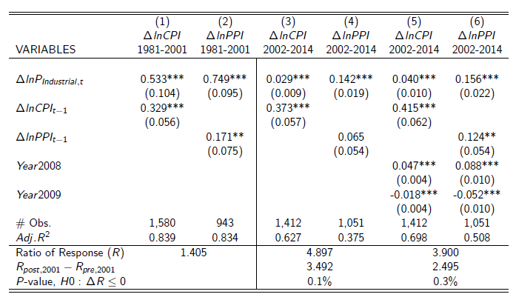
Empirical tests
Both CPI and PPI inflation respond less to industrial inputs price after 2001, and the responsiveness of CPI decreases faster than that of PPI.
Notes:
Also used commodity price as a robustness check, and similar pattern follows.
[Side note: from the coefficients on CPI response, the implied $ΔG ≈1.5$ across the two sub-samples.]

Slide 48
Empirical tests for the ratio of coefficients
In the regressions, the null hypothesis and alternative hypothesis in the test for the ratios of PPI and CPI elasticities are given by
H0:
$$\frac{∂ΔlnPPI/∂ΔlnP}{∂lnCPI/∂ΔlnP}{\left.​\right|}_{pre−2001}≥\frac{∂ΔlnPPI/∂ΔlnP}{∂lnCPI/∂ΔlnP}{\left.​\right|}_{post−2001}$$
H1:
$$\frac{∂ΔlnPPI/∂ΔlnP}{∂lnCPI/∂ΔlnP}{\left.​\right|}_{pre−2001}<\frac{∂ΔlnPPI/∂ΔlnP}{∂lnCPI/∂ΔlnP}{\left.​\right|}_{post−2001}$$
The test rejects the null hypothesis with p-value 0.1% and 0.3% respectively in the case with and without controlling the Great Recession period, and thus the ratio of coefficients are significantly larger after 2001.

Slide 49
Adding labor cost, CPI and PPI level data into control.

Slide 50
Disentangling the exchange rate pass-through effect.

Slide 51
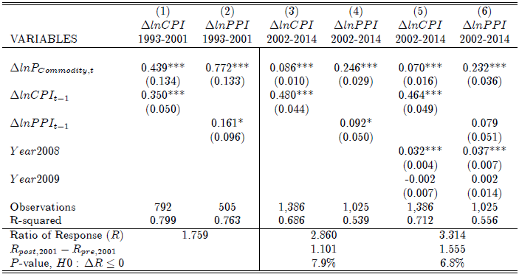
Empirical tests – robustness check
Using primary commodity price index from the IMF as a robustness check.
The change of the ratios are smaller than the case with using industrial input price index, which is consistent with its relative down-streamness.
Notes:
The smaller change of the ratios are consistent with intuition in the sense that the industrial input price, compared with primary commodity prices, are more up-stream.

Slide 52
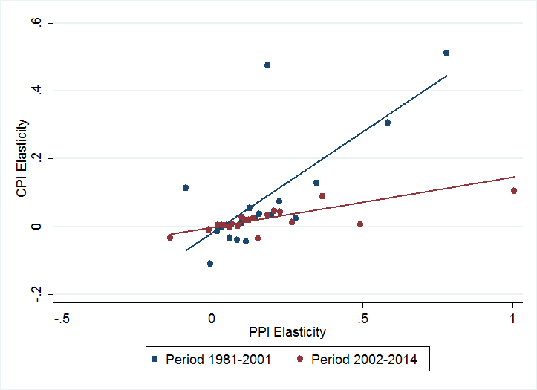
Empirical tests – assuming heterogeneous countries
$$ΔlnCPI_{t}^{n}=β_{1}^{n}ΔlnCPI_{t−1}^{n}+Σβ_{2}^{n}⋅I^{n}⋅ΔlnP_{IndustrialInputs,t}^{n}+X_{t}^{n}+ε_{CPI,t}$$
$$ΔlnPPI_{t}^{n}=γ_{1}^{n}ΔlnPPI_{t−1}^{n}+Σγ_{2}^{n}⋅I^{n}⋅ΔlnP_{IndustrialInputs,t}^{n}+X_{t}^{n}+ε_{PPI,t}$$
Notes:
The graph is the bin-scatter plot of the PPI and CPI elasticities for each country.

Slide 53
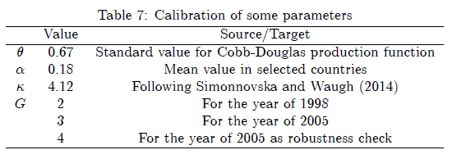
Calibration
Match the model to bilateral trade shares constructed from WIOD data in 1998 and 2005.
Focus on 40 countries included in WIOD.
Mapping target: bilateral shares of intermediate goods and final goods.
$2(N^{2}−N)$ moments in total.
Pre-determined variables:

Slide 54
Calibration
Trade costs: $τ^{in}=τ{\left(d^{in}\right)}^{ρ}$, where $d^{in}$ is the bilateral distance.
Assume the productivity parameter in service sector is the geometric mean of manufacturing sector for each country.
Normalize the productivity parameters of manufacturing sector in each stage of country 1 (USA) as unit.
Choice variables: ${\left\{T_{g=1,…,G}^{n},τ,ρ\right\}}_{n=2}^{N}$.
$G\left(N−1\right)+2$ unknown variables.
The model is over identified.

Slide 55
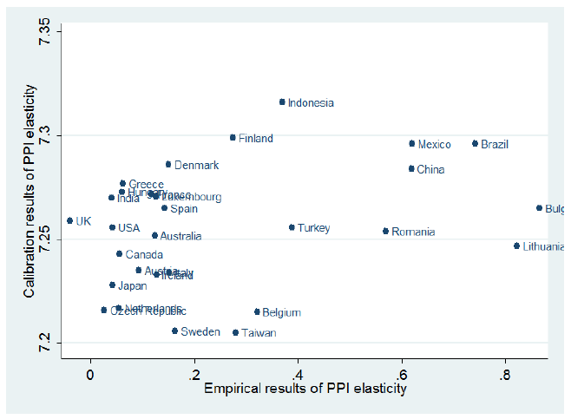
Empirics vs. calibration (two-stage): PPI response to industrial price shock (1998)
Notes:
The correlation between the calibration results and empirics is 0.314, and by regressing the calibrated results on empirical estimations, we get a statistically significantly positive coefficient, i.e., 0.036 with p-value 9.7%.

Slide 56
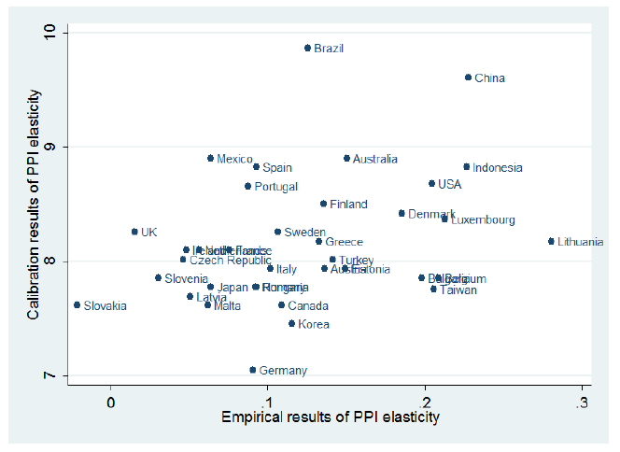
Empirics vs. calibration (three-stage): PPI response to industrial price shock (2005)
Notes:
The correlation between the calibration results and empirics is 0.315, and by regressing the calibrated results on empirical estimations, we also get a statistically significantly positive coefficient, i.e., 2.633 with p-value 6.1%.

Slide 57
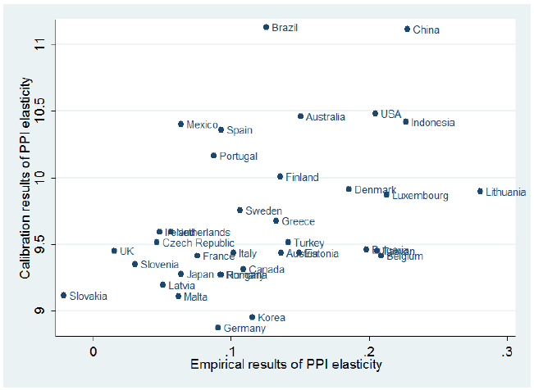
Empirics vs. calibration (four-stage): PPI response to industrial price shock (2005)
Notes:
The correlation between the calibration results and empirics is 0.426, and by regressing the calibrated results on empirical estimations, we also get a statistically significantly positive coefficient, i.e., 3.405 with p-value 1.0%.

Slide 58
Empirics vs. calibration
Y-axis: The response of PPI inflation to first stage technology shock calibrated by using 1998 and 2005 WIOD data.
X-axis: Country-specific response of PPI inflation to industrial input price shock constructed by empirical regression using data from 1981-2001 and 2002-2014.
Data before 2002
Data after 2002

Slide 59
Take-away
Correlation between CPI and PPI used to be high but started to decline after 2001.
Lengthening of GVCs may play an important role.
Implication: Optimal monetary policy needs to take into producer prices, whose weight depends on the nature of the production process.

